Slide 1


FaaS
applications
with AWS (FAA)
Team #15
Carolina Hernandez
Yash Jagda
Sagar Sahani
Notes:
I can remove with AWS and be SSA a new acronym for our research project. Or can I come with a better title. After we work on the proects
General name – Just API and APP -> Last will be the Benchmarking if I have time!!

Slide 2
Outline
Background
Motivation
Problem
Architecture
Main use cases
Research questions
Scope
Implementation
Technology stack
Front-end
Infrastructure code
Set Up
Observations/Evaluations
Demo
Conclusion
References

Slide 3
Background
The global serverless architecture market size is projected to grow from USD 7.6 billion in 2020 to USD 21.1 billion by 2025, at a Compound Annual Growth Rate (CAGR) of 22.7% during the forecast period. The major factors driving the growth of the serverless architecture market include the rising need of shifting the way enterprise build applications and services by removing the need to manage servers, thereby reducing the infrastructure cost.
Choosing to studying the serverless technique as the final research project to measure the best approach to build this infrastructures in the cloud is a relevant topic given that many IT companies from small to enterprise don’t have the knowledge or skills to capture the potential of serverless applications has in the real world to build high performing systems and applications in IoT, Data processing pipelines, and other areas.
Notes:
Market research – development, etc,
Serverless industry, applications, solutions, problem space, market cap and other things!!, new busines solutions, budget, etc.

Slide 4
Motivation
The team was highly interest in understanding serverless applications architecture and implementation.
The serverless architecture makes it possible for small companies to affordable to adopt a modern cloud infrastructure. Given that the team expertise doesn’t need to be highly specialized compared to other type of cloud architectures that demand managed services - like OS maintenance,etc.
Emerging technologies markets that rely heavily in function as a service architecture like conservational agents, IoT applications, AI/Machine learning, Data analysis pipelines demand on the enterprise.
Notes:
What does this achieve?

Slide 5
Problem
We decided to explore, research and learn how to build a small filesystem application that supports and handles multiple formats in the cloud. Adding up we went further and decided to test the application performance and learn how to measure it in real-time with a newly released serverless benchmarking suite named Faasdom.
The application is similar to the basic functions and the main purpose of major market applications like - dropbox, drive, box. Our approach differs from those applications in our architecture decision to develop a serverless app or function based deployment.

Slide 6
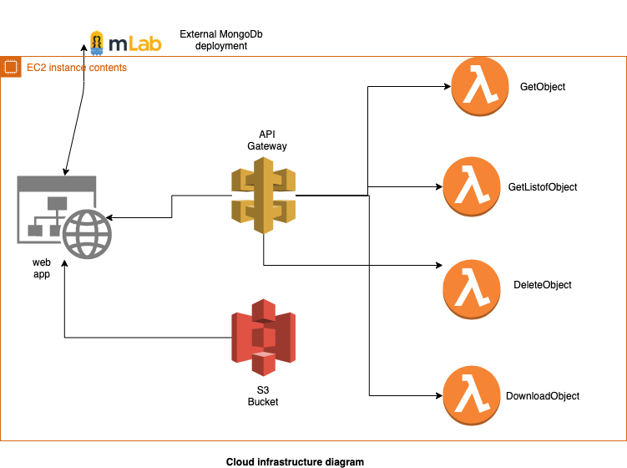
High-level filesystem architecture
Notes:
read the object, etc.

Slide 7
Main use cases
As a user i want to upload a file so that i can store it on other machine.
As a user i want to see all my files on the dashboard so that i can explore the list, size, name.
As a user i want to download the file on multiple devices.
As a user i want to be able to dele
Notes:
Should I include the authorization part for different users?, etc. - Not including admin, just the system user.
User stories or Use cases!!

Slide 8
Research questions
How to design a function based service application?
What’s the best approach to implement a filesystem using the AWS serverless stack and tooling?
What are the benchmarking results of the application to be implemented and what parameters are to be considered to be the most important to measure the performance on this type of application?

Slide 9
Scope
Observe the way a back-end serverless architecture can scale and perform in the cloud.
Recognize the constraints of this type of architecture.
Recognize the best practices to implement this technique.
Showcase comparisons results based on the performance metrics.

Slide 10
Implementation

Slide 11
Technology Stack
Web Application : Node.js , Express.js , MongoDB
Deployed : EC2 instances AWS, S3 object storage, lambda Functions, Mlab
Benchmarking tool : FaasDom - wrk2, cloud apis and clis, Grafana for graphics, DB: InfluxDB, Node.js runtime.
Notes:
We decided faasdom because it was more complete that serverless bench and we did the same performance tests.

Slide 12
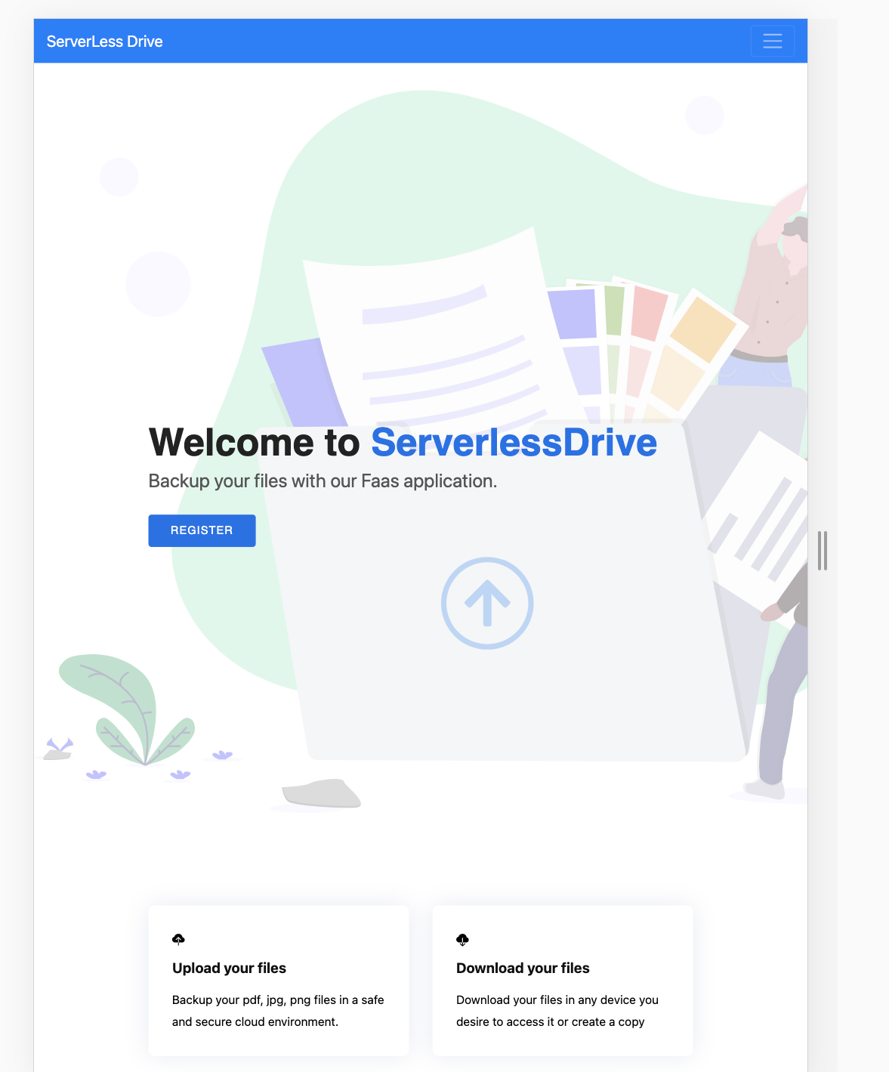
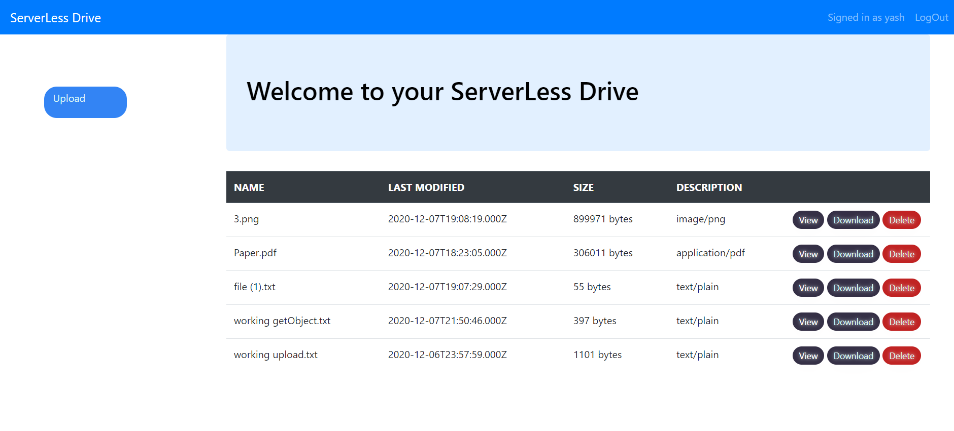
Front-end design

Slide 13
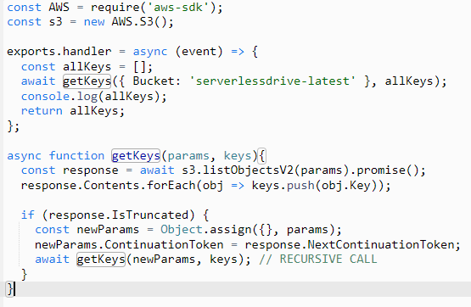
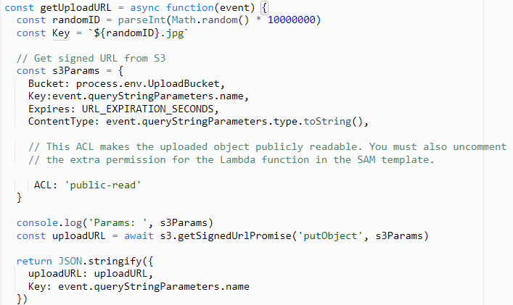
Infrastructure code

Slide 14
Demo

Slide 15
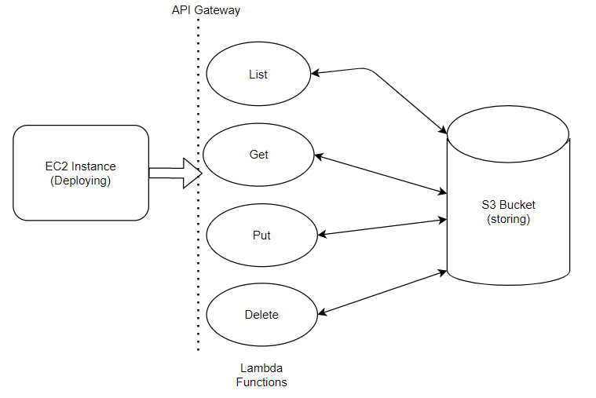
AWS services/Set up
Notes:
Screenshots of lambdas functions, S3 repository, DynamoDB tables fo project

Slide 16
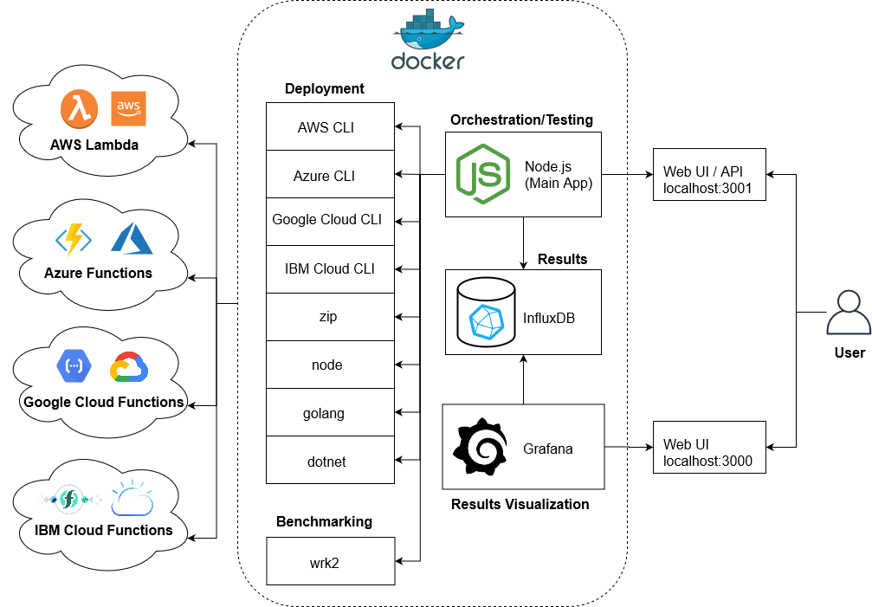
Faasdom - Benchmarking serverless tool

Slide 17
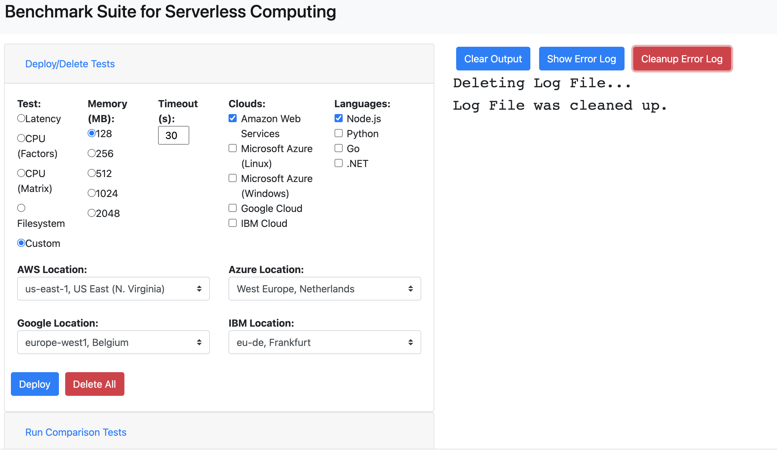

Slide 18
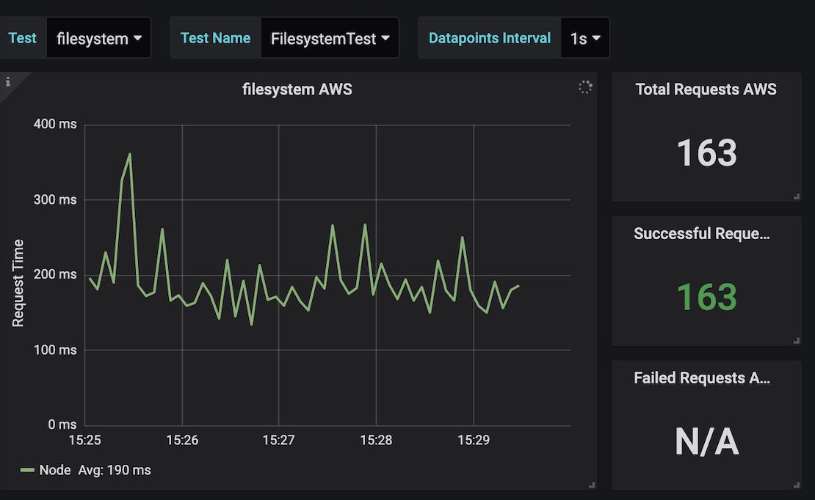
Benchmarking results with Faasdom suite
A simple file system execution load test by number of files=100, no. of characters=200 written for performance test.

Slide 19
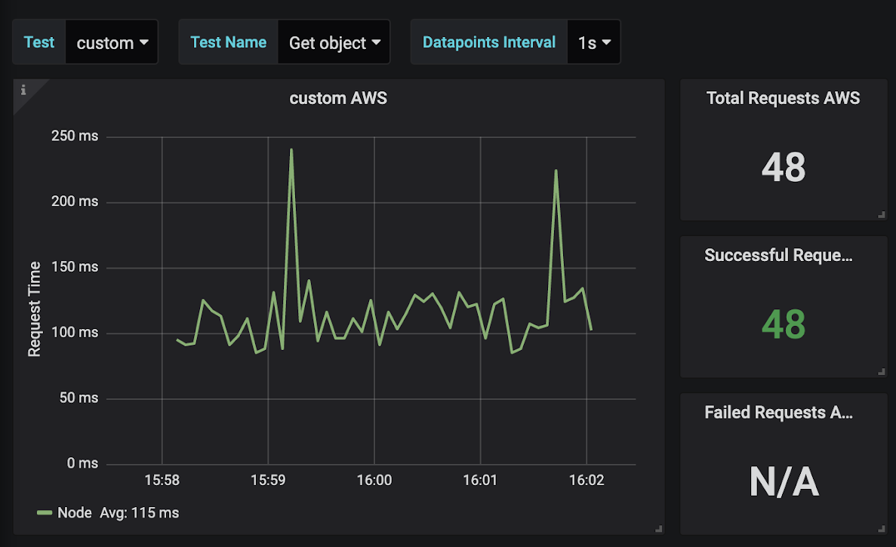
Getting object by id - Function performance

Slide 20
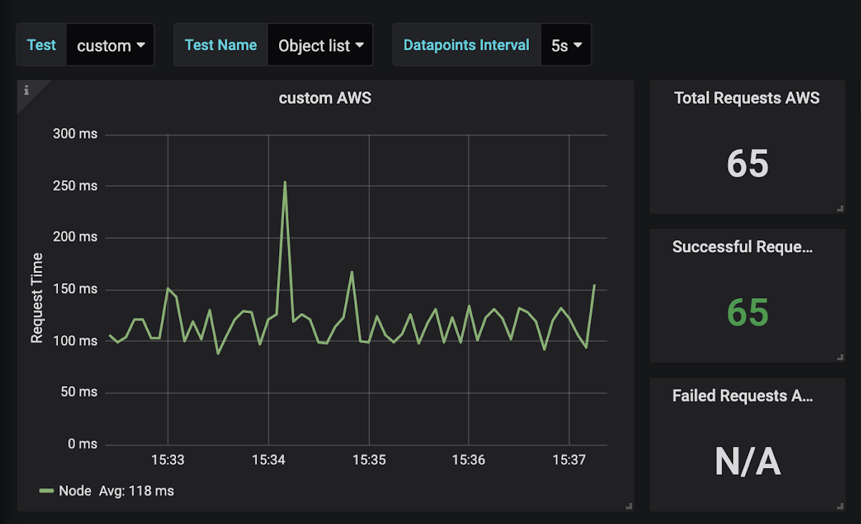
Object listing - Function performance

Slide 21
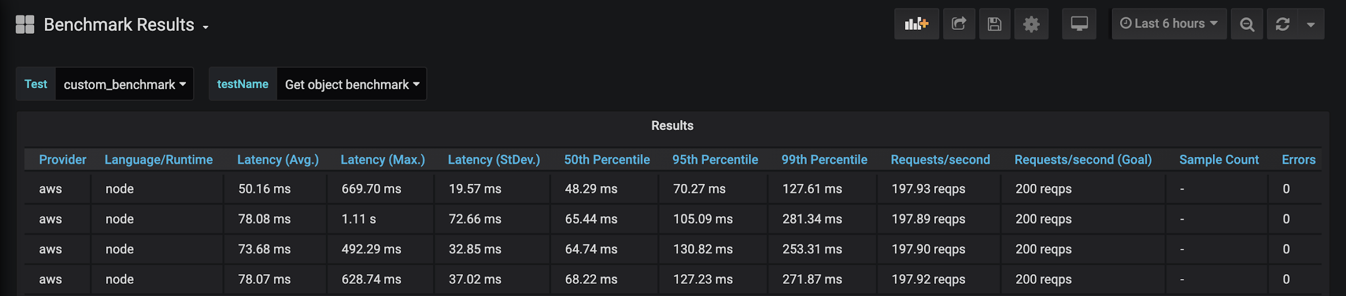
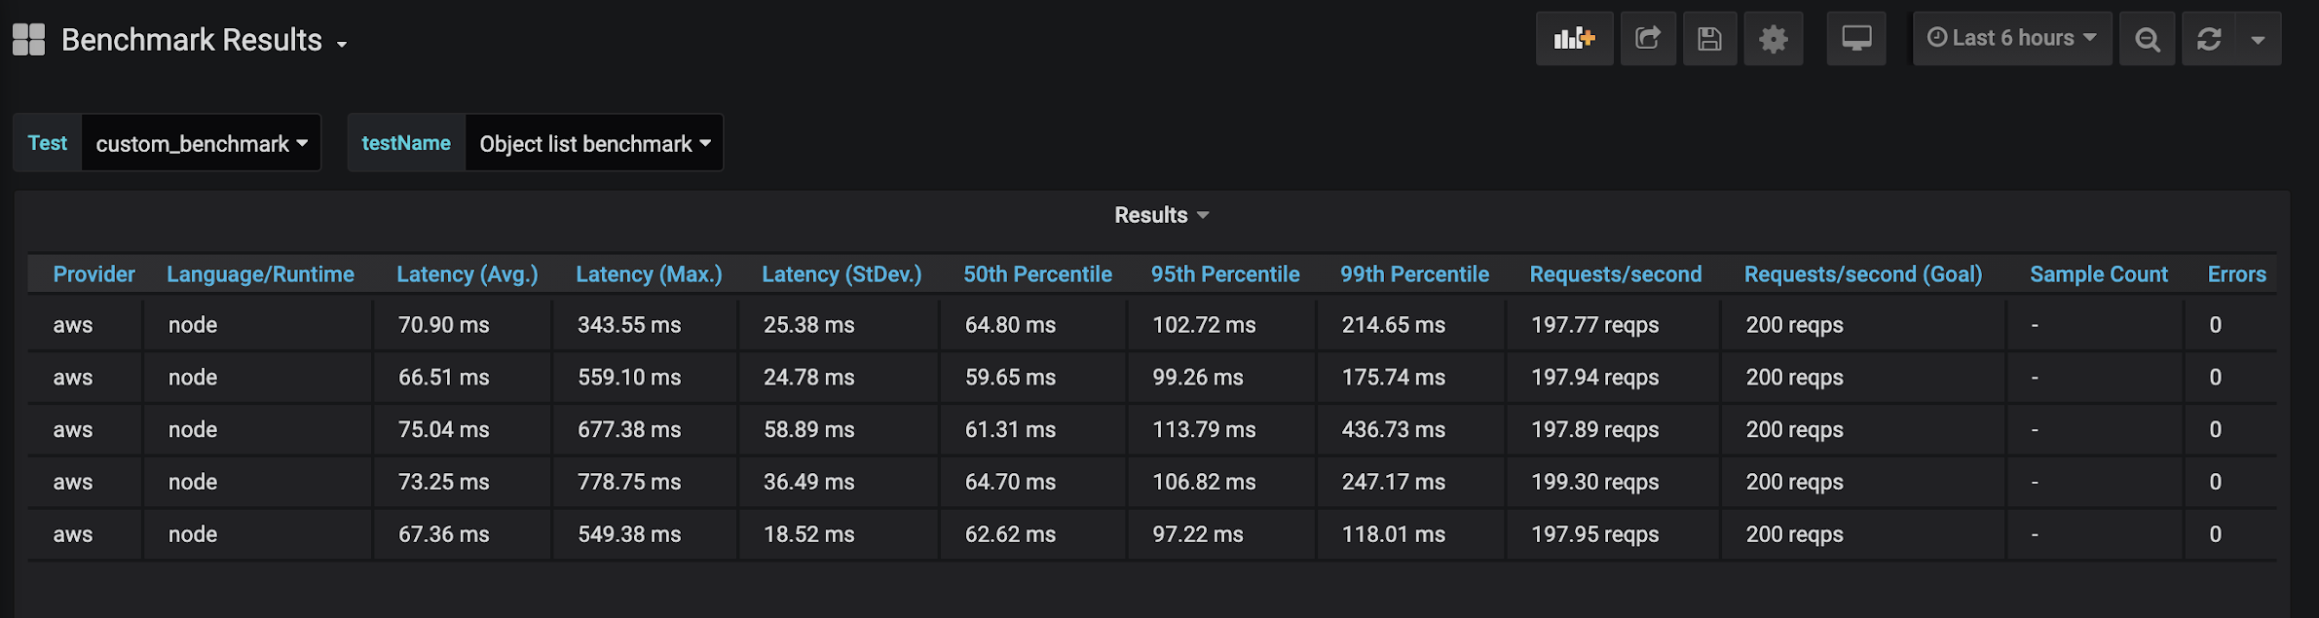
Benchmark results

Slide 22
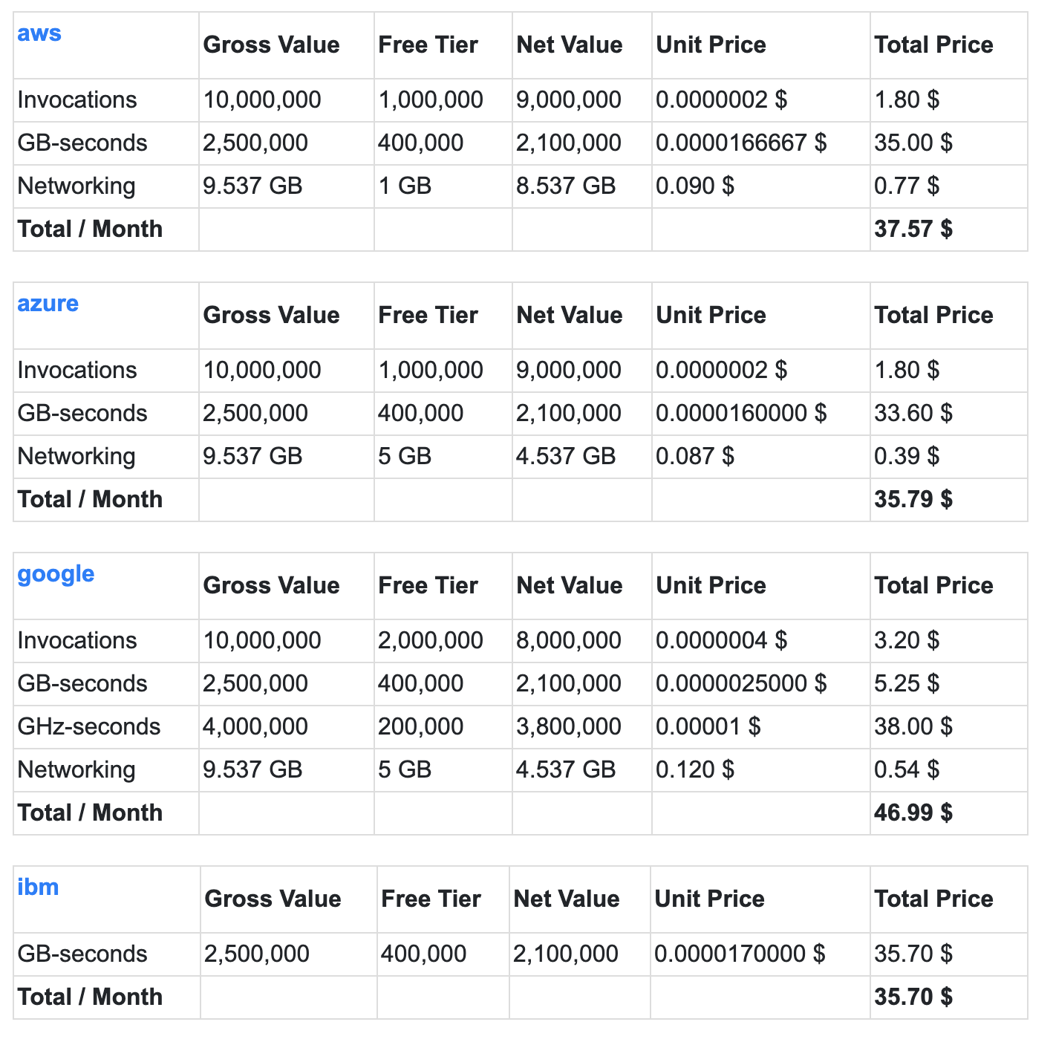
Major cloud providers - System cost comparisons

Slide 23
Conclusion
With the new cloud technology, vendors are trying to make it convenient for existing as well as new companies to port their technologies.

Slide 24
Q&A

Slide 25
References
Github link (Source code): https://github.com/codecella/filesystem
https://github.com/yashjagda/serverlessdrive
Final report link(Writing and Evaluation report):
Host/Domain link: http://ec2-3-19-75-28.us-east-2.compute.amazonaws.com:3000/
Learning resources/links
https://arxiv.org/pdf/2006.03271.pdf
https://serverlessbench.systems/socc20-serverlessbench.pdf
Notes:
Do citation the righ way – with dates, etc.

